Slide 1
RTOS Task Scheduler Simulator
Author: CHAITALI BABAR

Slide 2
Introduction
An RTOS executes multiple tasks with deterministic timing. This project simulates an RTOS scheduler in modern C++ without hardware.
A Task Scheduler is the core component of an RTOS (Real-Time Operating System) that decides which task (thread) should run on the CPU at any given time.
Since a microcontroller has only one CPU core, it cannot execute multiple tasks simultaneously. The scheduler creates the illusion of multitasking by rapidly switching the CPU between different tasks.

Slide 3
Objectives
• Build scheduler
• Manage tasks
• Simulate timer ticks
• Learn concurrency
• Write modular C++ code

Slide 4

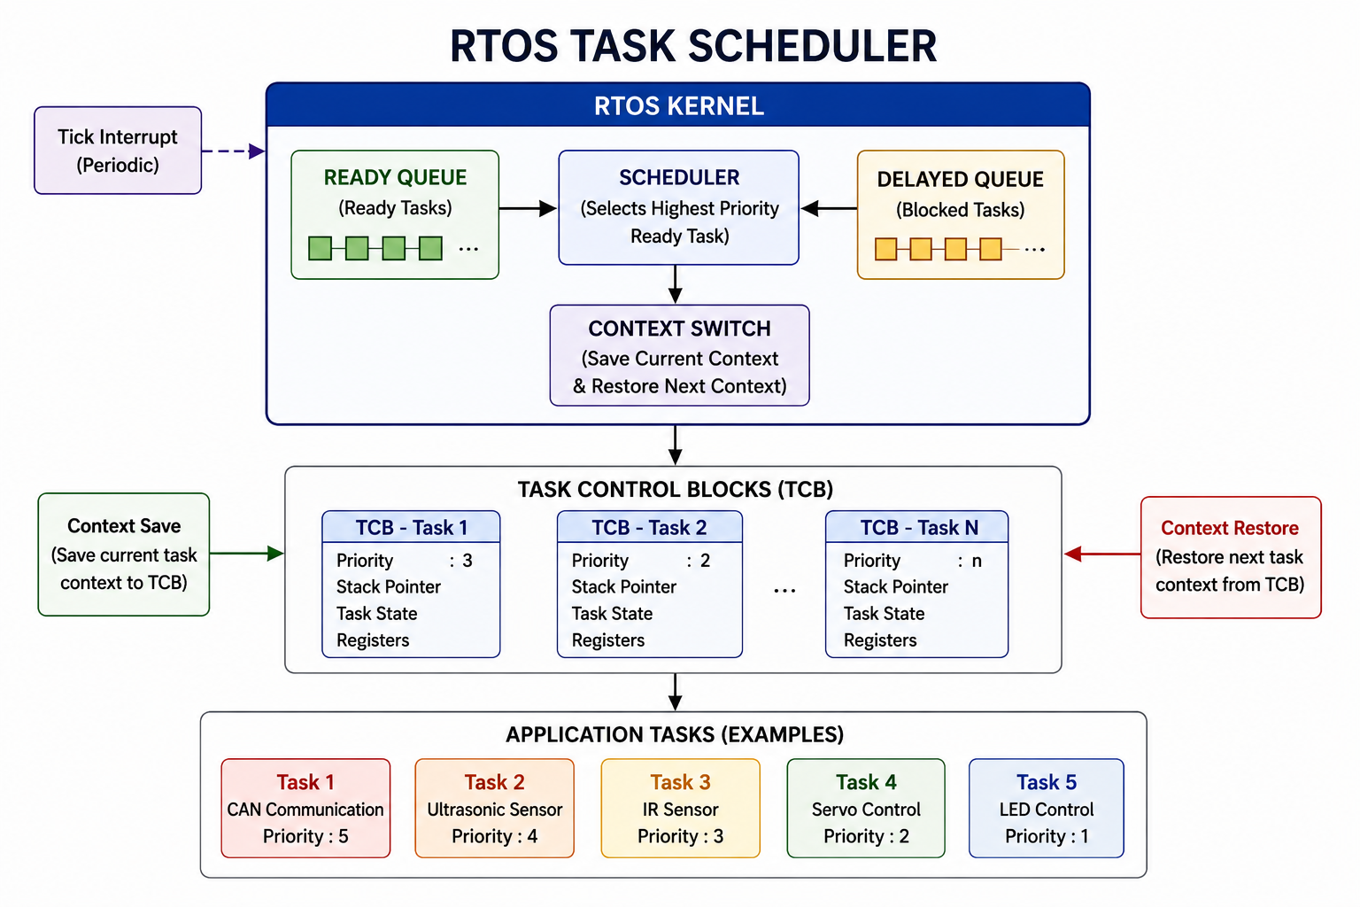
Block Diagram

Slide 5
RTOS Concepts
Task States:
Ready
Running
Blocked
Suspended
Terminated
Scheduling: Priority & Round Robin

Slide 6
System Architecture
CLI -> Scheduler -> Ready Queue
-> Timer
-> Logger
-> Task Objects

Slide 7
Modules
1. Task Manager
2. Scheduler
3. Timer Tick
4. Logger
5. Ready Queue

Slide 8
Algorithms
Priority Scheduling:
- Highest priority executes first.
Round Robin:
- Equal priority tasks share CPU using time slices.

Slide 9
Implementation
Language: C++17
Build: CMake
Version Control: Git
Documentation: README + SRS

Slide 10
Sample Console Output
Create Task A (P1)
Create Task B (P2)
Scheduler selects Task B
Task B completed
Scheduler selects Task A

Slide 11
Conclusion
The simulator demonstrates RTOS scheduling, task management and modern C++ design principles suitable for embedded software learning.

Slide 12
Thank You

